Slide 1

Project Title-Website builder
Submitted By
Himanshu Vishwakarma 2000290100070 Keshav Raj Yadav 2000290100080
Prateek Gupta 2000290100103
Under the supervision of
Prof. Hriday Kumar Gupta

Slide 2

ABOUT PROJECT:
A website builder tool allows you to design and create websites without having to edit code. User can do everything himself, without designers and developers. Without taking care of necessary backend and database user can get a customized website according to their needs and description.

Slide 3
OBJECTIVE:
1.Simplify website creation: Website builders aim to simplify the process of creating a website, making it accessible to individuals and businesses without technical expertise.
2. Provide pre-built templates and design elements: Website builders provide pre-built templates and design elements that can be easily customized, eliminating the need for users to design their website from scratch.
3. Allow for customization: Website builders allow users to customize their website, ensuring that it reflects their brand and meets their specific needs.

Slide 4

TECHNOLOGY IMPLEMENTED:
Front-end frameworks and libraries: Website builders require user interfaces that are easy to use and visually appealing. Front-end frameworks and libraries like React, Vue.js.
Database management systems: Website builders need a way to store user data, templates, and other resources. Database management systems like MySQL, MongoDB.
API integrations: Website builders often integrate with third-party applications and services, such as payment gateways, email marketing tools, and social media platforms.

Slide 5
PROGRESS:
Templates added :-
1.Blog website – blog templates that are added have the functionalities of- • Creating new Blogs with title, images and description.
2.E-Commerce website – E-Com templates that are added has the functionality of- ▪ Adding new items into the catalog. ▪ Customizing category section.

Slide 6
Backend setup for database:-
Created an Atlas MongoDB cluster for common file storage for different websites of users.
Rendering the data through postman to validate APIs.
Stripes Integration :-
Stripe is a leading online payment gateway that simplifies electronic transactions for businesses. Renowned for its seamless integration, user-friendly interface, and robust security features.

Slide 7

RESEARCH PAPER:
Title: DOMAIN NAME SYSTEM POTENTIAL THREATS AND SECURITY MEASURES
Abstract: The Domain Name System (DNS), which acts as the standard naming scheme for machine-routable Internet Protocol (IP) addresses of Internet resources and human-readable domain names, is one of the most important components of the modern Internet. However, over time, DNS's security and operation have been continually questioned due to its susceptibility to different assaults. This article addresses the employed data analysis techniques, which are commonly used to solve DNS threat weaknesses, in addition to the DNS threat landscape and current difficulties.

Slide 8
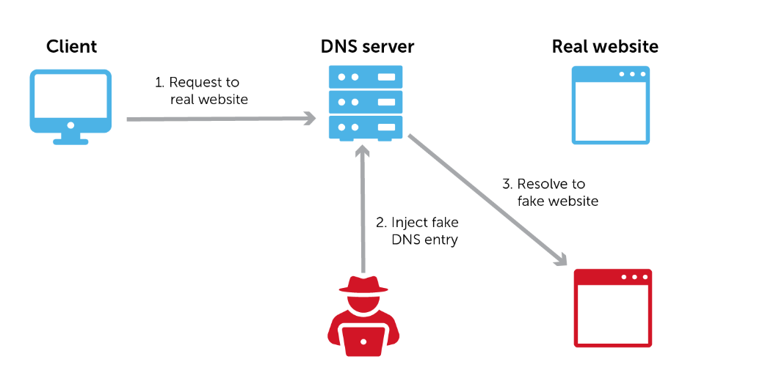

Slide 9
DNS VULNERABILITIES:
DNS CACHE POISONING:-DNS cache poisoning is a type of cyber attack that aims to corrupt or manipulate the data stored in the DNS (Domain Name System) cache of a DNS resolver. The DNS cache is used to store previously resolved domain name-to-IP address mappings, allowing faster retrieval of this information when requested by clients. When an attacker successfully poisons the DNS cache, they can redirect legitimate DNS queries to malicious IP addresses.
DNS HIJACKING:-DNS hijacking, a malicious activity synonymous with DNS redirection or DNS poisoning, poses a significant threat to the security and integrity of internet communications. In this exploitative maneuver, attackers intercept and modify Domain Name System (DNS) queries or responses, manipulating the translation of human-readable domain names to IP addresses. By gaining unauthorized control over DNS settings, attackers redirect legitimate domain requests to malicious websites, exposing users to phishing attacks and potential compromise of sensitive information.

Slide 10
Preventions:
DNSSEC: A collection of protocols intended to strengthen DNS security is known as DNS Security Extensions (DNSSEC). It makes it far more difficult for attackers to tamper with the cache by using digital signatures to confirm the legitimacy of DNS data . The IETF developed DNSsec to guarantee both the authenticity of the data's source and its integrity. DNSsec uses public key cryptography as its foundation to offer various security services.
Delay Fast Packets (DFP):Prevention of DNS Cache Poisoning:The main objective of the DFP algorithm is to approximate the Round Trip Time (RTT) between the DNS server and every authoritative server it comes across.

